Slide 1
Electronic Devices and Circuits
Dr. Junaid Ahmed

Slide 2
Contents
Full-wave rectifier
Center-tap rectifier
Full-bridge rectifier
Output frequency of Full-wave rectifier
Efficiency of Full-wave rectifier
Nature of rectifier output
Ripple factor
Comparison of rectifiers

Slide 3
Full-wave rectifier:
In full-wave rectifier, current flow towards load in the same direction for the both half cycles of input a.c. voltage
Two diodes are used to achieve full wave rectification.
Full-wave utilizes both half cycles of the a.c. input voltage to produce d.c. output.
For positive half-cycle, one diode supplies current to load, for negative half cycle, second diode supplies current to load.
Two circuit are most commonly used for full-wave rectification.
Center-tap full wave rectifier
Full-wave bridge rectifier

Slide 4
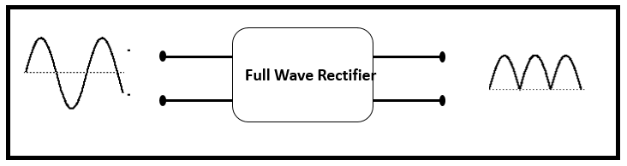
Full-wave rectifier: (cont.)

Slide 5
Full-wave rectifier: (cont.)
Center-Tap Full-Wave Rectifier:
Circuit consist of two diodes D1 and D2.
A center tapped secondary winding transformer is also used with two diodes connected so that each diode uses half cycle of a.c. input.
Both diodes respond to input from the respective (upper and lower) half winding of centre tapped transformer.

Slide 6
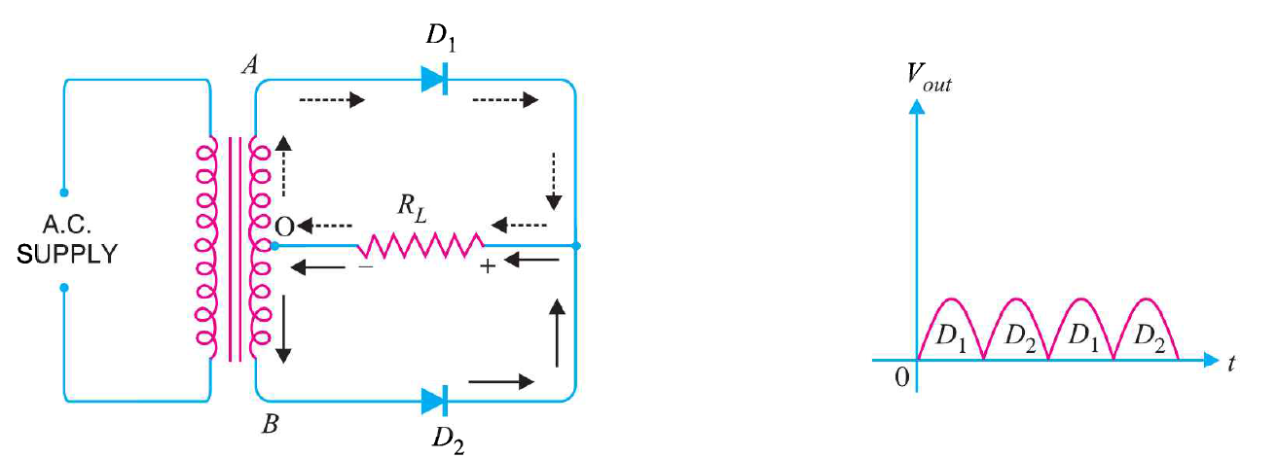
Full-wave rectifier: (cont.)
Center-Tap Full-Wave Rectifier: (Circuit details and working mechanism)

Slide 7
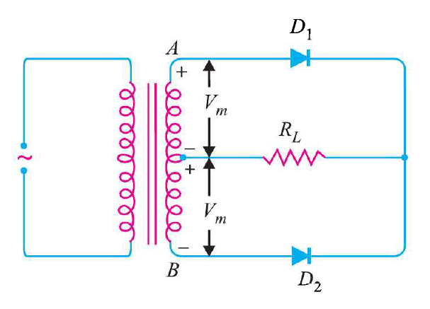
Full-wave rectifier: (cont.)
Center-Tap Full-Wave Rectifier: (Peak inverse voltage)
PIV = 2Vm

Slide 8
Full-wave rectifier: (cont.)
Center-Tap Full-Wave Rectifier:
(Advantages)
Efficiency is high because ac supply delivers power during both the halves

Slide 9
Full-wave rectifier: (cont.)
Center-Tap Full-Wave Rectifier:
(Disadvantages)
It is difficult to locate the center tap on the secondary winding.
The d.c. output is small as each diode utilizes only one-half of the transformer secondary voltage.
The diode used must have peak inverse voltage.

Slide 10
Full-wave rectifier: (cont.)
Center-Tap Full-Wave Rectifier:
(Applications)
This type of rectifier circuits only used where the center tapped transformer is used. Generally, in earlier days, full wave rectifier using center tapped transformer is used for the battery charger circuits.
For high power applications, center tapped full wave rectifier is used to eliminate large voltage drop across the diodes. The high power diodes also costly. There is a chance of frequent damage of diodes in high power applications.
In earlier Transistor Radios, center tapped full wave rectifier is used because in those days the cost of silicon rectifier diodes was very high.

Slide 11
Full-wave rectifier: (cont.)
Full-Wave Bridge Rectifier:
Full wave bridge rectifier four diodes are arranged in the form of a bridge.
This configuration provides same polarity output with either polarity.
The main advantage of this bridge circuit is that it does not require a special Centre tapped transformer.
The single secondary winding is connected to one side of the diode bridge network and the load to the other side

Slide 12
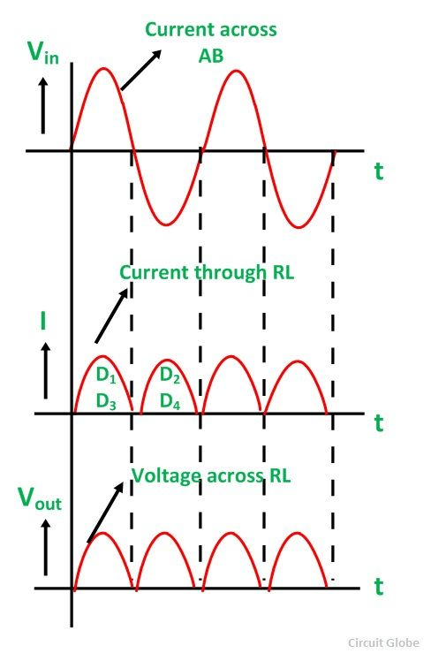
Full-wave rectifier: (cont.)
Full-Wave Bridge Rectifier: (cont.)

Slide 13
Full-wave rectifier: (cont.)
Full-Wave Bridge Rectifier:
(Circuit details and working mechanism)
The four diodes labelled D1 to D4 are arranged in series pairs with only two diodes conducting current during each half cycle duration.
When the positive half cycle of the supply goes, D1, D2 diodes conduct in a series.
Diodes D3 and D4 are reverse biased and the current flows through the load.
During the negative half cycle, D3 and D4 diodes conduct in a series.
Diodes D1 and D2 switch off as they are now reverse biased configuration.

Slide 14
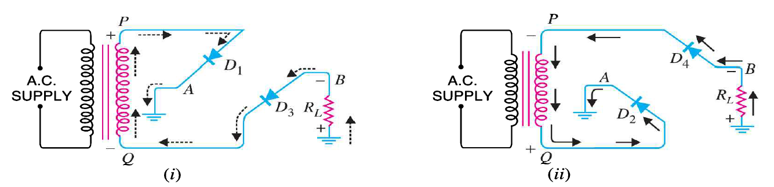
Full-wave rectifier: (cont.)
Full-Wave Bridge Rectifier:
(Circuit details and working mechanism)

Slide 15
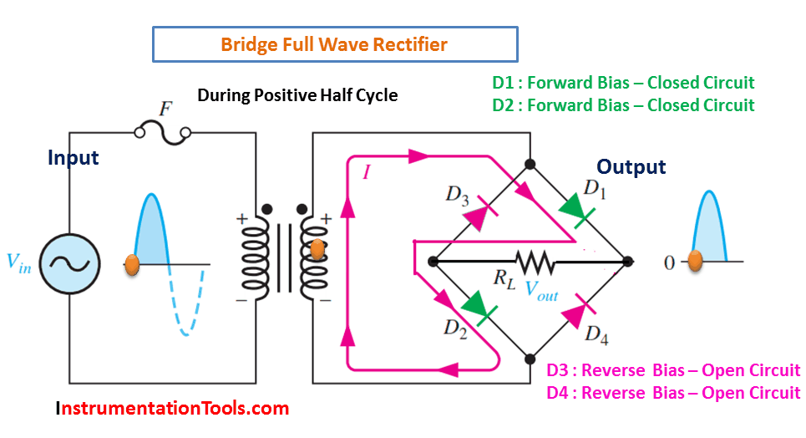
Full-wave rectifier: (cont.)
Full-Wave Bridge Rectifier:
(Working mechanism for positive half cycle)

Slide 16
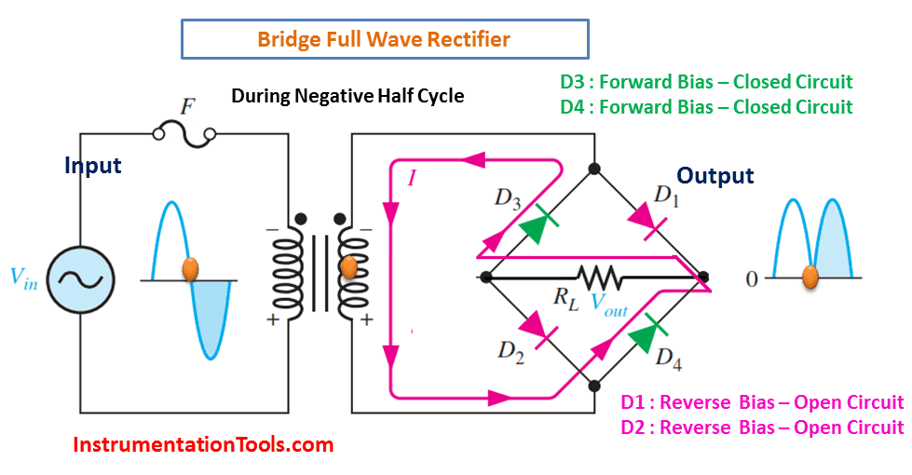
Full-wave rectifier: (cont.)
Full-Wave Bridge Rectifier:
(Working mechanism for negative half cycle)

Slide 17
Full-wave rectifier: (cont.)
Full-Wave Bridge Rectifier:
(Circuit details and working mechanism)
Current flowing through the load is unidirectional mode.
The voltage developed across the load is also unidirectional voltage.
Same as for the previous two diode full-wave rectifier model.
During each half cycle the current flows through two diodes instead of just one diode.

Slide 18
Full-wave rectifier: (cont.)
Full-Wave Bridge Rectifier:
(Advantages)
The need of center-tapped transformer is eliminated.
The output is twice that of the center tap circuit for the same secondary voltage.
The PIV is one half that of the center-tap circuit.

Slide 19
Full-wave rectifier: (cont.)
Full-Wave Bridge Rectifier:
(Disadvantages)
It needs four diodes, two of which conduct in alternate half-cycles. Because of this the total voltage drop in diodes becomes double of that in case of center-tap rectifier, losses are increased and rectification efficiency is somewhat reduced. This poses a problem when low voltages are required.

Slide 20
Full-wave rectifier: (cont.)
Full-Wave Bridge Rectifier:
(Applications)
Full Wave Bridge Rectifier is used to detect the amplitude of the modulating radio signal.
Bridge rectifier circuits are also used to supply steady and polarized d.c. voltage in electric welding.
The Bridge Rectifier circuits are widely used in power supply for various appliances, as they are capable of converting the High AC voltage into Low DC voltage.
Full-wave rectifiers are also used for powering up the devices which work on DC voltage like motor and led.

Slide 21

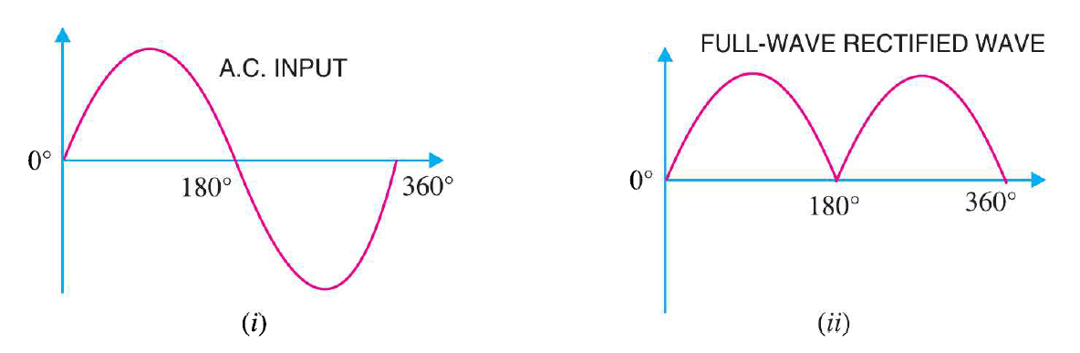
Full-wave rectifier: (cont.)
Output Frequency:

Slide 22
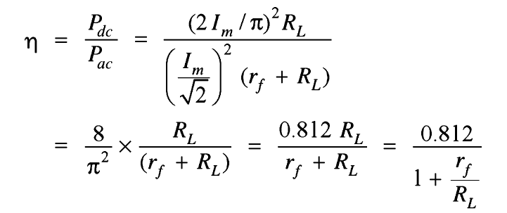
Full-wave rectifier: (cont.)
Efficiency:
Consider r_{f} is negligible as compare to R_{L}
Max. efficiency = 81.2%

Slide 23
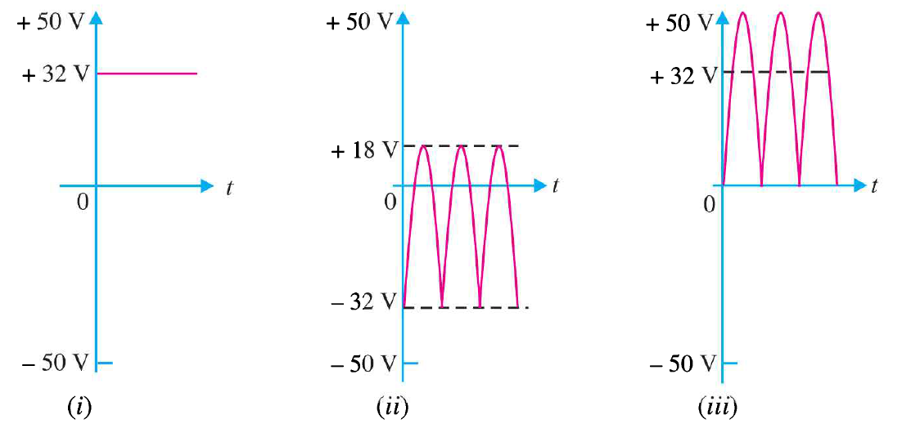
Nature of Rectifier Output:
(i) d.c. component
(ii) a.c. component
(iii) Resultant wave of (i) & (ii)

Slide 24
Ripple Factor:
The output of rectifier consists of D.C component and A.C component also known as ripple.
This A.C component in output is undesirable and accounts for the pulsations in the rectifier output.
AC component in rectifier output voltage is called ripple voltage and AC component in output current called ripple current.
“The ratio of r.m.s. value of a.c. component to the d.c. component in the rectifier output is known as the ripple factor.”

Slide 25
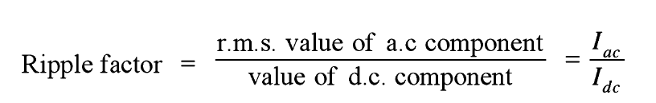
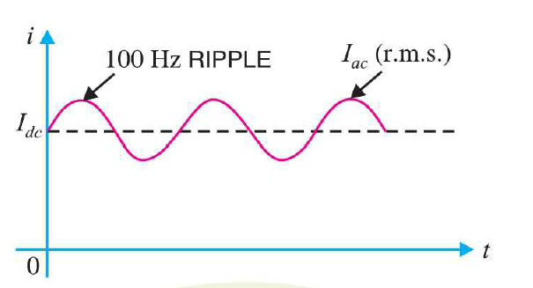
Ripple Factor: (cont.)

Slide 26
Ripple Factor: (cont.)
Ripple Factor is very important in deciding the effectiveness of rectifier output.
The smaller ripple factor describes the more effectiveness of that rectifier.
The more ripple factor means more fluctuating ac components are present in the rectified output.
This is basically a measurement of ripple which denotes the purity of rectified output.

Slide 27
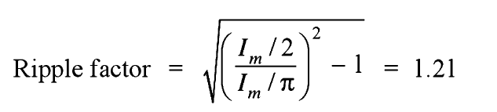
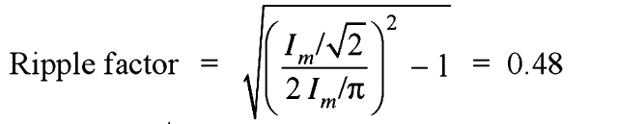
Ripple Factor: (cont.)
Mathematical analysis:
For Half wave rectification:
For Full wave rectification:

Slide 28
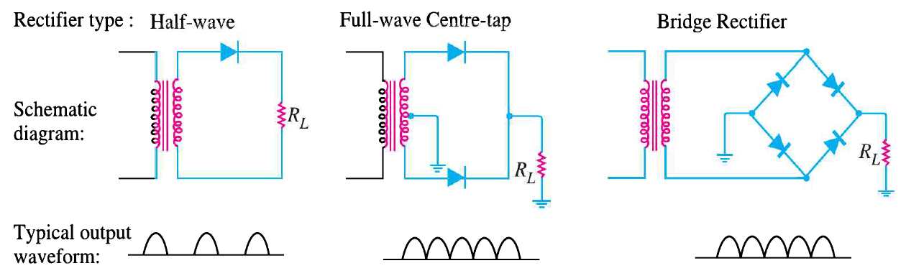
Comparison of rectifiers:

Slide 29
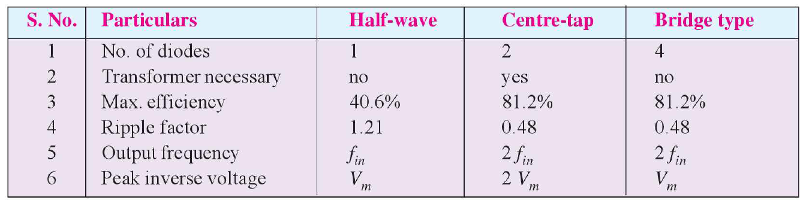
Comparison of rectifiers: (cont.)

Slide 30

Any Questions ????????

